Slide 1
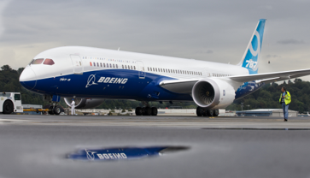


Bellevue
Air
The hidden truth behind airline safety

Slide 2
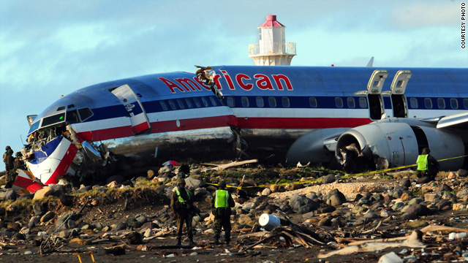
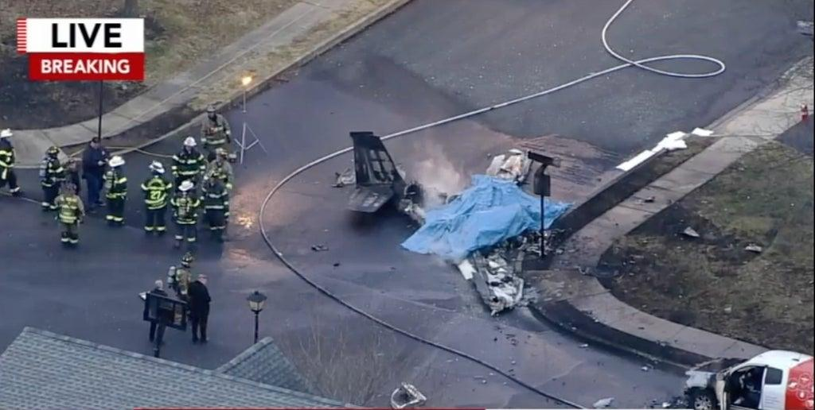


WHAT YOU HEAR ABOUT AIRLINE SAFETY
Bellevue Air
Planes crash all the time
Everyone dies during a crash
Airlines have done nothing with safety

Slide 3

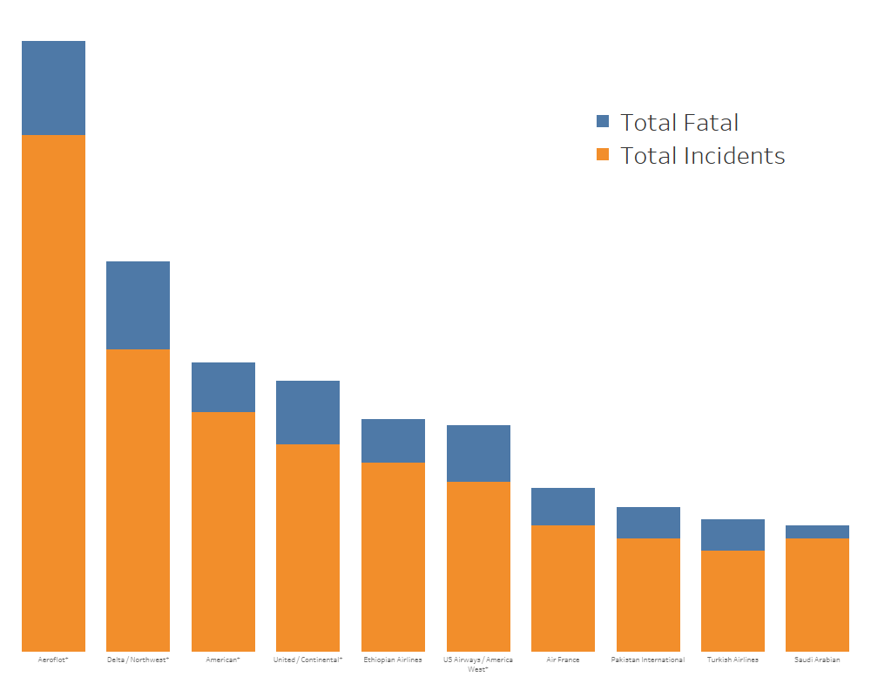


MEDIA MYTHS DEBUNKED
Bellevue Air
10
AIRLINES CONTRIBUTE TO 57% OF ALL FATAL ACCIDENT
77% DECREASE
IN
INCIDENTS SINCE 1997
ADDITIONAL
22% DECREASE
IN THE NEXT 3-5 YEARS

Slide 4

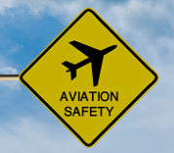




OUR PROMISE TO YOU
The safety of you and your family is
PRIORITY # 1
Bellevue Air
We strive for 100%
customer satisfaction
Our well-trained pilots and crew are here to serve YOU!
Improving our fleet to meet your needs

Slide 5
